Slide 1
Voice Based Age and Gender Detection using Long Short - Term Memory
Student Research Competition in FPT University
Year 2024
Nguyen Minh Nhut, Nguyen Thanh Trung, Nguyen Huu Tan,
Luong Dang Doanh, and Duc Ngoc Minh Dang
FPT University, Ho Chi Minh Campus, Vietnam

Slide 2
Introduction
In recent times, there have been notable advancements in the field of voice-based recognition systems, specifically in the areas of distinguishing gender and age.
This project explores using Long Short-Term Memory (LSTM) networks to predict age and gender from voice recordings.
Student Research Competition in FPT University

Slide 3
Related Work
Age classification model
Age Output
Extract Feature
Gender prediction through voice in Deep Learning is a potent technique for determining an individual’s gender based on their voice characteristics.
Depending on the model’s complexity, it may incorporate various layers such as Convolutional Neural Network (CNN), recurrent, temporal CNN, or fully connected layers.
These models consist of layers designed to extract features from audio files, such as tone and pitch.
Input Data
Gender Output
Gender classification model

Slide 4
Architecture of Voice-based Age and Gender Classification
Age classification model
Age Output
Input Data
Extract Feature
Gender classification model
Gender Output

Slide 5
Age Dataset
Percent | Train | Valid | Test
20% | 2655 | 296 | 158
20% | 2674 | 277 | 158
20% | 2647 | 304 | 158
20% | 2658 | 293 | 158
20% | 2645 | 306 | 158
20-29
40 -49
30- 39
0 -19
Over 50

Slide 6
Gender Dataset
01
04
Percent | Train | Valid | Test
50% | 2685 | 315 | 1000
50% | 2715 | 285 | 1000
Male
02
05
Female
03
06

Slide 7
Feature Extraction
01
Mel-Frequency Cepstral Coefficients (MFCC)
04
Shifted Delta Coefficients
02
Delta Mel-Frequency Cepstral Coefficients
05
Pitch Estimate
03
Delta Delta
Mel-Frequency Cepstral Coefficients
06
Magnitude Estimate

Slide 8
Long Short-Term Memory (LSTM)
Long Short – Term Memory (LSTM) is a type of Recurrent Neural Network (RNN) that can process and analyze sequential data.
They use a memory cell and gates to control the flow of information, allowing them to selectively retain or discard information as needed and thus avoid the vanishing gradient problem that plagues traditional RNNs.
LSTMs are widely used in various applications such as natural language processing, speech recognition, and time series forecasting.
Recurrent Neural Network
Long Short – Term Memory

Slide 9
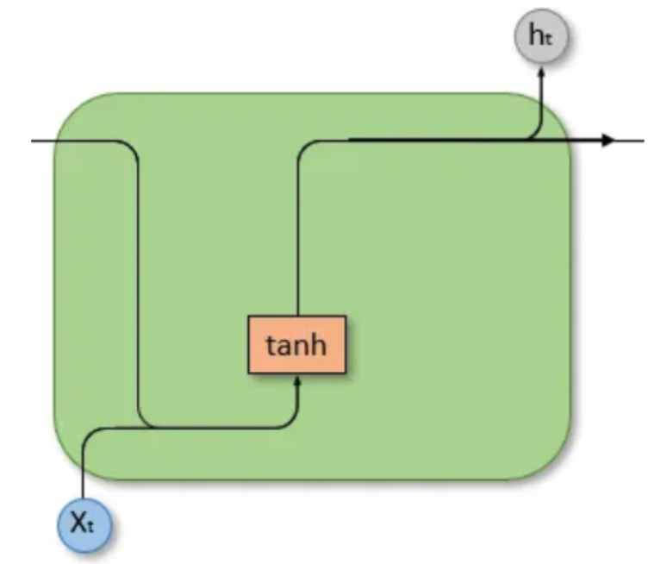
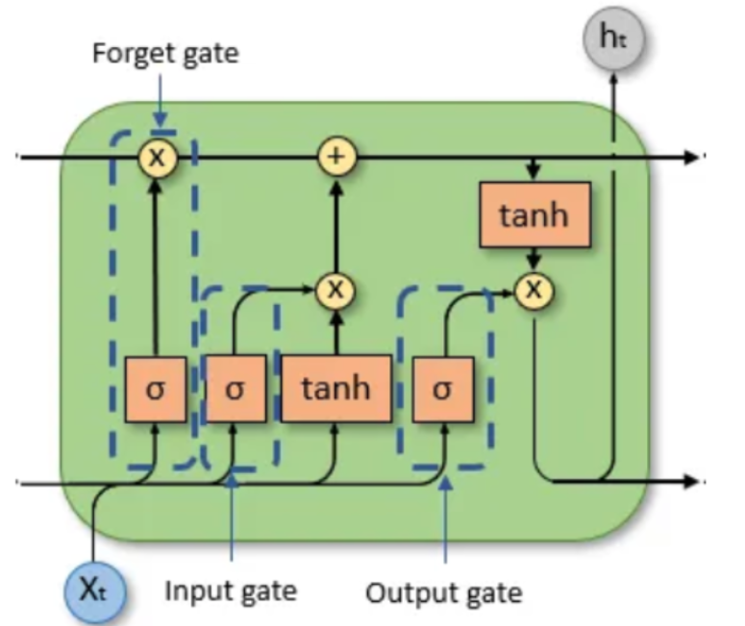
Long Short-Term Memory (LSTM)
Age classification model
Age Output
Extract Feature
Input Data
Recurrent Neural Network
Long Short – Term Memory
Gender Output
Gender classification model

Slide 10
Proposed Gender Classification Model
Input Feature
LSTM (256 nodes)
Normalisation
Dropout layer (0.3)
LSTM (256 nodes)
Dropout layer (0.3)
FCN (128 nodes)
FCN (64 nodes)
Activation = ReLU
Activation = ReLU
Dropout layer (0.3)
Dropout layer (0.3)
Batch Normalization
Batch Normalization
FCN (2 nodes)
Activation = Softmax
Output

Slide 11
Proposed Age Classification Model
FCN (64 nodes)
FCN (5 nodes)
Activation = ReLU
Activation = Softmax
Input Feature
Dropout layer (0.3)
Normalisation
Output
Batch Normalization
LSTM (256 nodes)
FCN (128 nodes)
Dropout layer (0.3)
Activation = ReLU
LSTM (256 nodes)
Dropout layer (0.3)
Dropout layer (0.3)
Batch Normalization
FCN (256 nodes)
FCN (128 nodes)
Activation = ReLU
Activation = ReLU
Dropout layer (0.3)
Dropout layer (0.3)
Batch Normalization
Batch Normalization

Slide 12
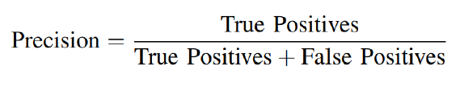

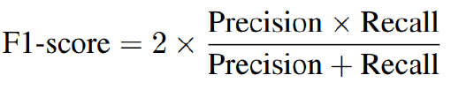
Performance Metrics
Actual Values
 | Positive | Negative
Positive | True Positive | False Positive
Negative | False Negative | True Negative
Predicted
Values
Precision
Recall
F1 - Score

Slide 13
Experience Result of Gender Classification Model
 | Precision | Recall | F1 - scored
Male | 0.91909 | 0.88600 | 0.90224
Female | 0.88996 | 0.92200 | 0.90570
Accuracy |  |  | 0.90400
Macro average | 0.90452 | 0.90400 | 0.90397
Weighted average | 0.90452 | 0.90400 | 0.90397
The overall performances metrics of Gender Classification Prediction

Slide 14
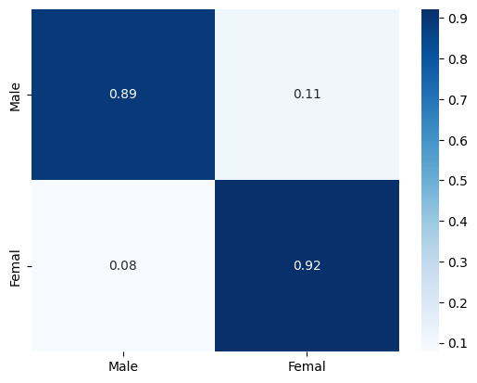
Experience Result of Gender Classification Model
Confusion Matrix of Normalizing
Gender Classification Prediction

Slide 15
Experience Result of Age Classification Model
 | Precision | Recall | F1 - scored
Fifties – Sixties | 0.87283 | 0.96178 | 0.91515
Forties | 0.78495 | 0.92994 | 0.85131
Teens | 0.80000 | 0.91720 | 0.85460
Thirties | 0.79381 | 0.98089 | 0.87749
Twenties | 0.82692 | 0.27389 | 0.41148
Accuracy |  |  | 0.81274
Macro average | 0.81570 | 0.81274 | 0.78201
Weighted average | 0.81570 | 0.81274 | 0.78201
The overall performance metrics of Age Classification Prediction

Slide 16
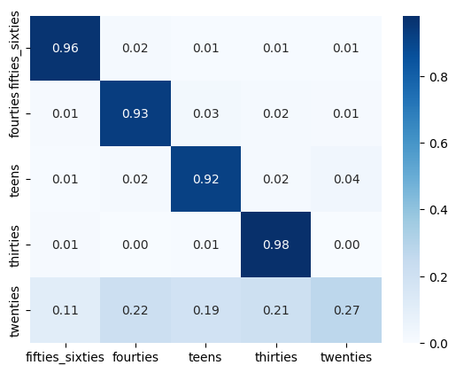
Experience Result of Age Classification Model
Confusion Matrix of Normalize for
Age Classification Prediction

Slide 17
The future application and importance of the project
Short - term
Long - term
Comparision with another model and larger dataset.
Tracking Speaker's voice and remove noise of environment.
Automatically route calls.
Age restrictions on accessing applications.

Slide 18
Conclusion
The Voice Recognition System shows promise in gender and age identification tasks, with notable success in age prediction despite struggles with accents. Further enhancements could overcome these classification, making it valuable for diverse applications relying on voice-based age prediction.
Student Research Competition in FPT University

Slide 19
Voice Based Age and Gender Detection using Long Short - Term Memory
Student Research Competition in FPT University
Year 2024
Thank you for listening
Nguyen Minh Nhut, Nguyen Thanh Trung, Nguyen Huu Tan,
Luong Dang Doanh, and Duc Ngoc Minh Dang
FPT University, Ho Chi Minh Campus, Vietnam

